Slide 1
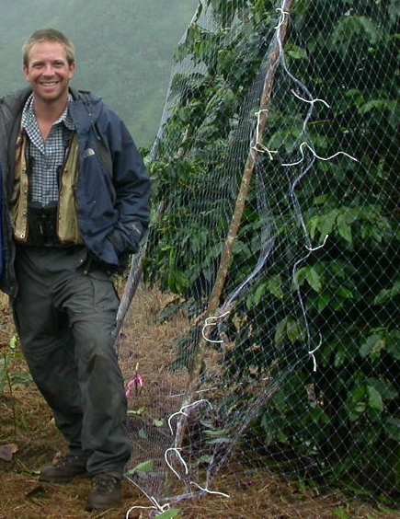
Using Purpose and Patterns to Design a Model: The Jamaica Coffee Farm Example
Steve Railsback
Matt Johnson (Department of Wildlife, Humboldt State U.)

Slide 2
Some major problems in using IBMs
Finding the right level of complexity
Einstein: “We should make things as simple as possible, but not simpler” – How??
We are not used to thinking across levels
IBMs are population models based on individual traits, but we are only interested in individual traits that affect the population
How do we capture the real mechanisms that drive some dynamic of a system?
How do we know we have a good model of individual traits, other mechanisms??

Slide 3
Pattern-Oriented Modeling Phase 1: Use patterns to design the model
(1) Identify useful patterns
The first “filter” for deciding what to include in any model is the problem the model is to solve...
include only stuff necessary to solve the problem
A clearly-stated problem is essential for designing a model... but for complex models it is not sufficient
Too many ways to solve the same problem
What entities, variables, processes, etc. really capture the system’s inner workings??

Slide 4
Phase 1: Use patterns to design the model
The model needs to include
Processes that cause the patterns
Structures & variables that are essential to the patterns
The scales that patterns occur at
(Little else--Leave out anything unimportant to the patterns)

Slide 5
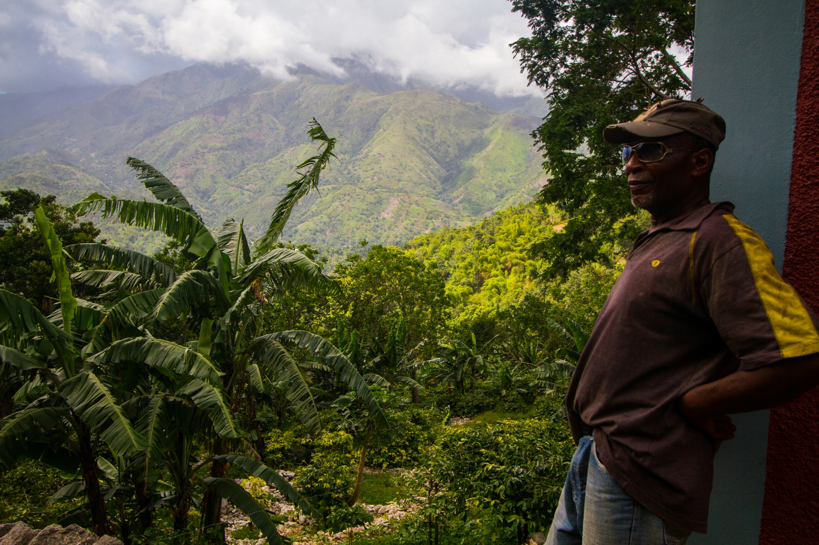

Slide 6
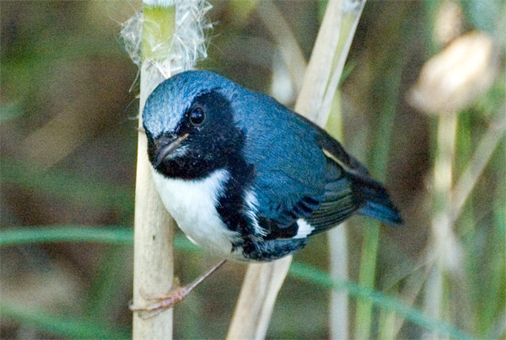
Birds, Beetles, and Coffee
Black-throated blue warbler (good guy)
Coffee borer beetle (CBB) (bad guy)

Slide 7
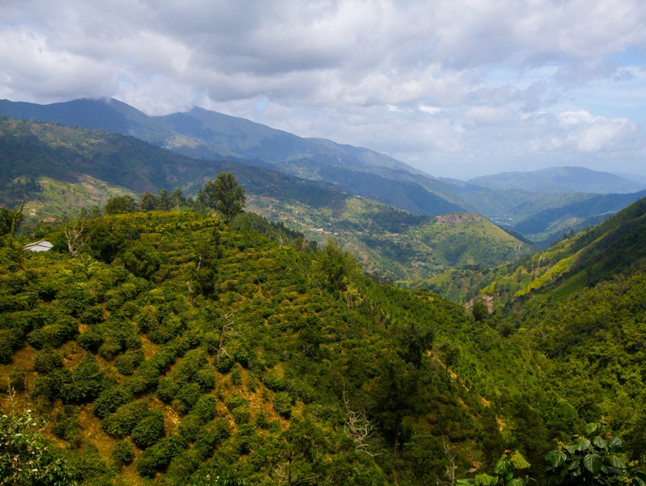
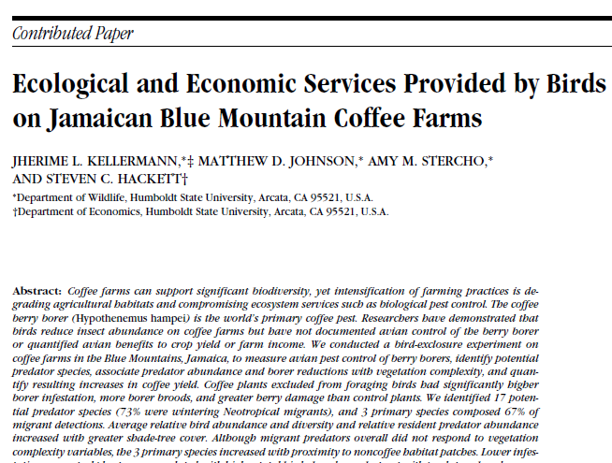
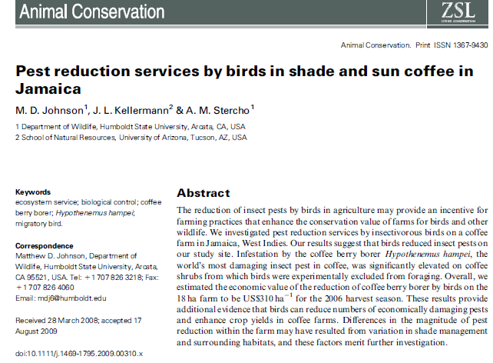

Slide 8
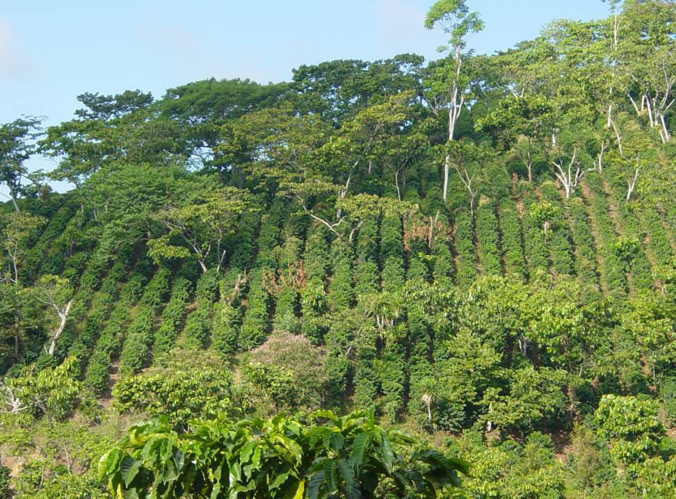
Coffee farms have diverse habitat, with diverse foraging for birds

Slide 9
Model purpose

Slide 10
Model purpose
The model’s purpose is to explore the effects of changes in coffee farm management on suppression of CBB by birds.
In particular it is designed to help us understand and predict how the relative area and spatial arrangement of several common habitat types, especially high- and low-shade coffee, affect local bird densities and the reduction of CBB infestation rates by birds.

Slide 11
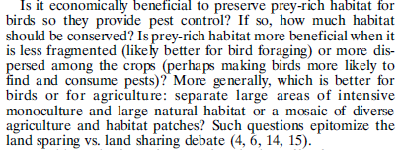
Model purpose--restated
Railsback, S. F. and M. D. Johnson. 2014. Effects of land use on bird populations and pest control services on coffee farms. Proceedings of the National Academy of Sciences of the United States of America 111:6109-6114.

Slide 12
Model purpose--restated
??
??
Railsback, S. F. and M. D. Johnson. 2014. Effects of land use on bird populations and pest control services on coffee farms. Proceedings of the National Academy of Sciences of the United States of America 111:6109-6114.

Slide 13
How do we design this model?
What “characteristic patterns” have been observed in the system?
What do these patterns tell us about what needs to be in the model?

Slide 14
What do these patterns tell us about a model’s structure??
What entities must be in the model so it can possibly reproduce the patterns?
What spatial and time scales are needed to reproduce the patterns?
What processes cause the patterns and so should be in the model?

Slide 15
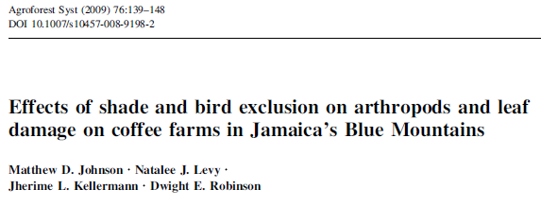
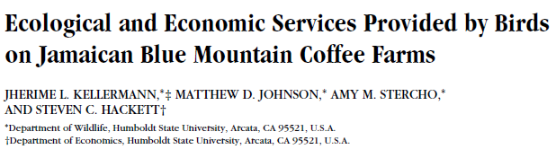
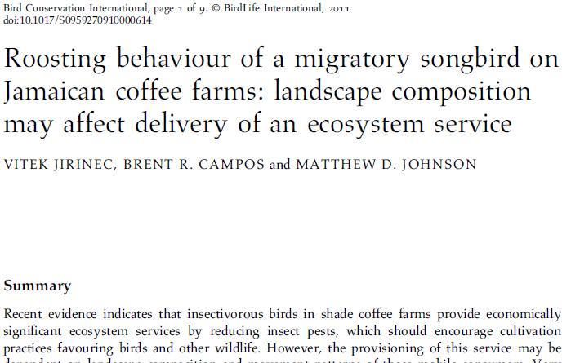
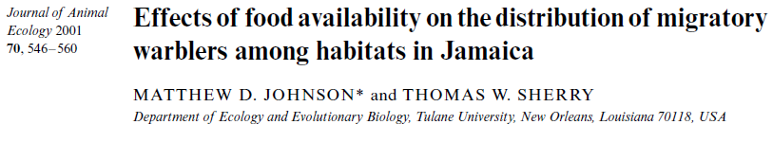
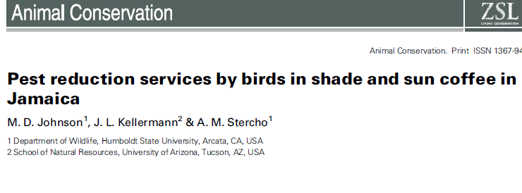

Slide 16
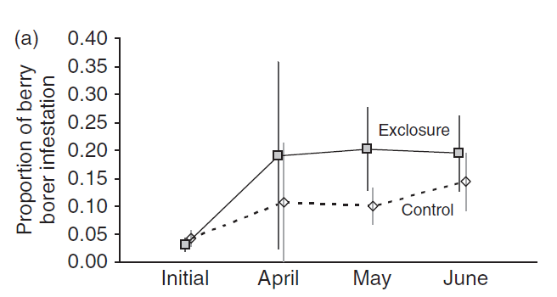
Pattern 1:
CBB infestation rates increase over the coffee growing season and are higher on coffee bushes that birds are excluded from

Slide 17
Pattern 3:
Bird densities are 2-3 times higher in shade coffee vs. sun coffee
(because there is more food in shade coffee habitat)

Slide 18
Pattern 4:
The percent reduction in CBB infestation by birds is higher where CBB infestation rate is higher

Slide 19
Pattern 5:
Bird densities increase rapidly when there is a short-term, sharp increase in food availability (a bug irruption)

Slide 20
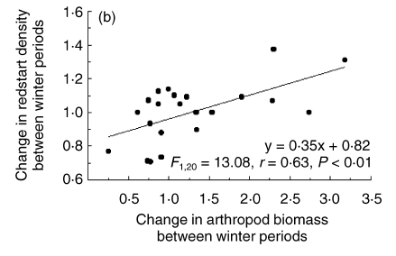
Pattern 6:
Changes in landscape-wide bird densities over a season are related to food availability: bird density went down when food went down, and up when food went up

Slide 21
Pattern 9:
Consumption of CBB by birds is episodic:
CBB make up only 8% of overall food, but
For short periods, CBB are almost 100% of a bird’s diet

Slide 22
Summary: What the patterns tell us about model’s structure
Many patterns are changes over time, so model must be dynamic
Many patterns are differences among habitat types, so the model must be spatial
at resolution fine enough (5 m²) to represent the small patches of vegetation that typify the farms

Slide 23
What do these patterns tell us about a model’s structure??
Many patterns are changes over time, so model must be dynamic
Many patterns are differences among habitat types, so the model must be spatial
at resolution fine enough (5 m²) to represent the small patches of vegetation that typify the farms
Bird foraging is the key adaptive behavior

Slide 24
What do these patterns tell us about a model’s structure??
Many patterns are changes over time, so model must be dynamic
Many patterns are differences among habitat types, so the model must be spatial
at resolution fine enough (5 m²) to represent the small patches of vegetation that typify the farms
Bird foraging is the key adaptive behavior
Birds move often, so we need a short time step (1 min)

Slide 25
To potentially reproduce the patterns we need to represent...
CBB infestation rate (% of coffee berries with beetles in them)
varying over time and between shade- and sun coffee
NOT CBB population dynamics
Exclosures (three patterns are results of exclosure experiments)
Bug irruptions (pattern 5)
Mortality / emigration due to food shortage (pattern 6 relates changes in bird density to food)

Slide 26
So— Coffee farm model scales and entities:
Time scales:
Daily time step but– birds select a cell every minute
Cells:
200 x 200 cells, each 5 m in width
Each cell is one of 6 habitat types
Initialized into “clumps” of habitat types
Variables for bug availability and CBB infestation rate
Birds: 3000 initial birds with variables:
Location (which patch)
Energy level

Slide 27
So— Coffee farm model processes:
Bug production
CBB infestation update
Birds reset energy level to empty
Birds forage (once per minute, up to 12 hrs, until they obtain daily energy need)
Birds may starve if they do not obtain daily energy need

Slide 28
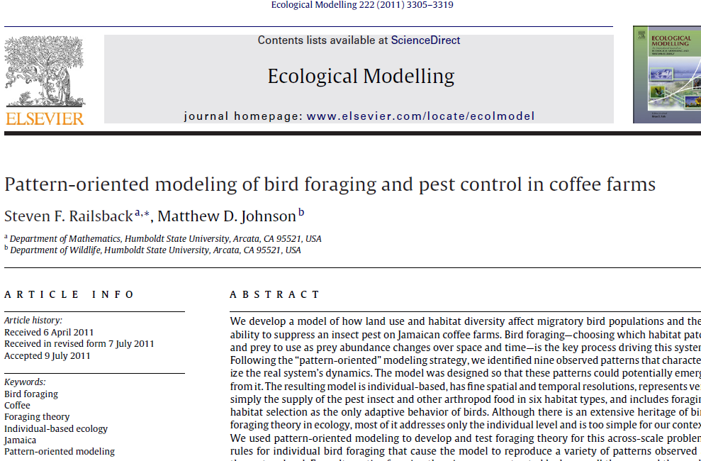
Details:

Slide 29
(demo)

Slide 30
Conclusions for POM model design
Basing a model’s design explicitly on a clear purpose and on observed patterns makes your model:
Much easier to build
Look like science instead of ad hoc
Helps you stop building and start analyzing (and eventually finish and get your degree)

Slide 31
The pattern-oriented theory development cycle
Proposed theories: alternative traits for a key individual behavior
IBM
How well does IBM reproduce observed patterns?
Empirical literature, research
Characteristic patterns of emergent behavior

Slide 32
Foraging theory in the coffee farm model
How do individual birds decide which habitat cell to forage in, when:
Different habitat types have different food production
Food consumed by one bird is no longer available to others
One bird uses up most of a cell’s food within a few minutes
Scales:
5 × 5 meter cells
1 minute time step, up to 12 hours per day

Slide 33
Foraging hypothesis 1
Dr. Grimm’s advice: Always start with a “null” hypothesis (simplest possible)
As a baseline for comparison to other hypotheses
To see how important the behavior is

Slide 34
Foraging hypothesis 1
Random (a “null” theory):
randomly choose one of 9 neighborhood cells

Slide 35
Foraging hypothesis 2
The inverse of Dr. Grimm’s advice: Include an extremely smart behavior

Slide 36
Foraging hypothesis 2
Random
Optimal cell (long range):
Always select the cell with highest intake rate
within a radius of 100 meters

Slide 37
Foraging hypothesis 3
My advice: Include some ‘classical’ theory (because it is fun to show why it makes no sense)
Classical theory of bird foraging ??

Slide 38
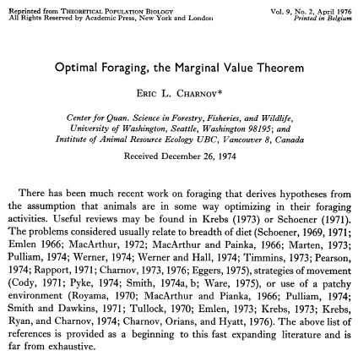
Charnov (1976) “Marginal value theorem” (cited 3688 times)
The theory: Maximize intake by foraging in one patch until food is depleted to landscape average
Problems: ??

Slide 39
Charnov (1976) “Marginal value theorem”
The theory: Maximize intake by foraging in one patch until food is depleted to landscape average
Problems:
Doesn’t say where to move to
What is “landscape average” when food is constantly being depleted by competitors?
Landscape average food availability may not be sufficient to keep the individual alive

Slide 40
Foraging hypotheses
Random
Optimal cell – long distance
Optimal departure (based on Charnov 1976 “marginal value theory”):
Stay in a cell until food is depleted so that bird cannot meet its daily intake requirement
Then move randomly to a neighbor cell

Slide 41
Foraging hypothesis 4
My advice: Think through the relevant ODD design concepts and think about behavior that would be smart but realistic
What objective would birds use to select a cell?
Over what radius could birds sense food availability in a 1-minute time step?

Slide 42
Foraging hypotheses
Random
Optimal cell – long distance
Optimal departure
Optimal cell – short distance

Slide 43
The pattern-oriented analysis of foraging behavior theory
Patterns observed on Jamaican coffee farms | Theory 1: Random cell selection | Theory 2: Optimal departure | Theory 3: Optimal cell (short range) | Theory 4: Optimal cell (long range)
Pattern 1: | ✓ | ✓ | ✓
Pattern 2: |  |  | ✓ | ✓
Pattern 3: |  | ✓ | ✓ | ✓
Pattern 4: |  | ✓ | ✓ | ✓
...
Pattern 9:

Slide 44
Pattern 3: Bird densities are higher in shade vs. sun coffee
Shade Sun
Shade Sun
Shade Sun
Shade Sun
Random
Optimal departure
Optimal cell- short range
Optimal cell- long range

Slide 45
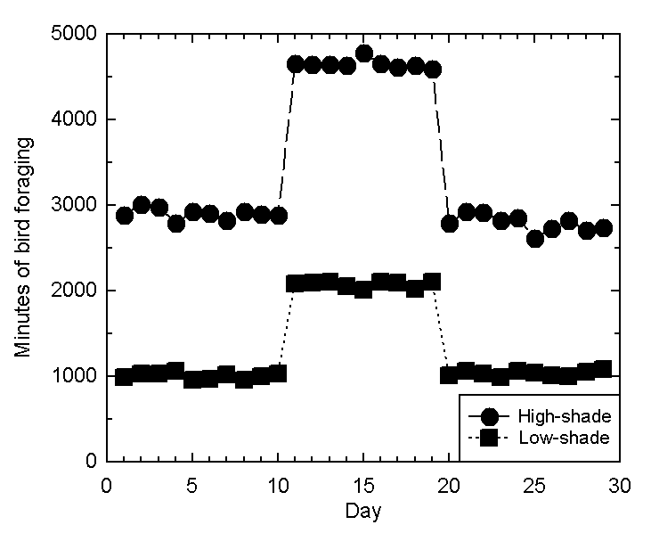
Pattern 5: Birds respond to local food irruptions
Optimal cell- short range
(Optimal cell-
long range
is similar)

Slide 46
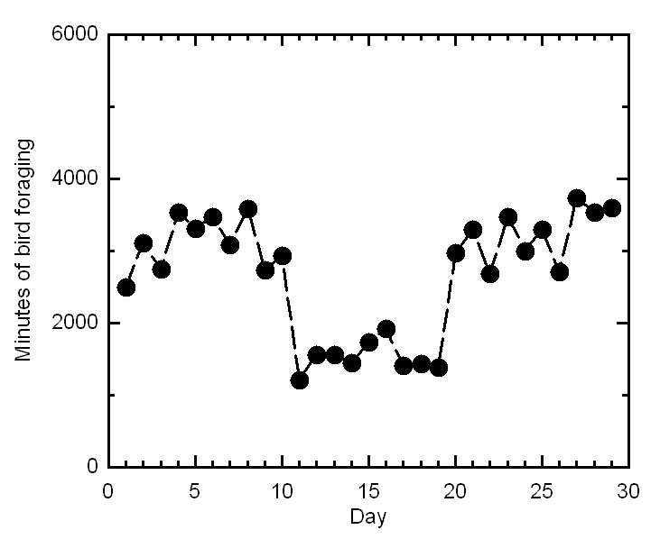
Pattern 5: Birds respond to local food irruptions
Optimal
departure
Birds cannot seek high-food cells
Birds that randomly enter high-food cells finish their daily feeding sooner

Slide 47
Pattern 8: Bird movement distances, measured hourly, follow a log-normal distribution

Slide 48
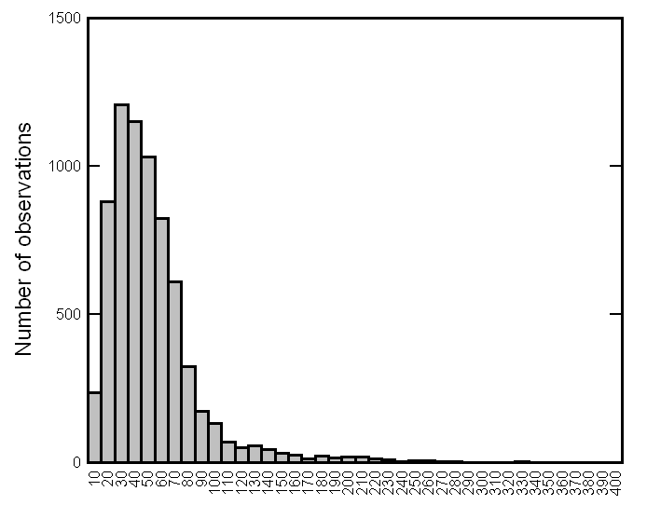
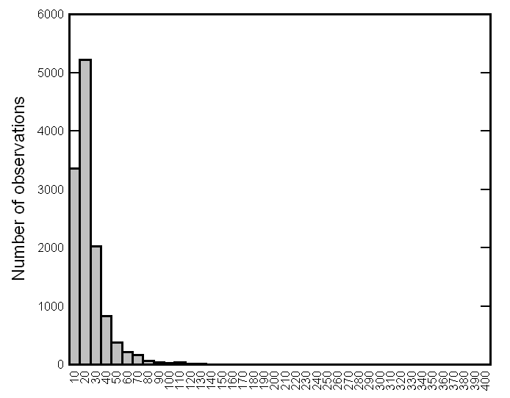
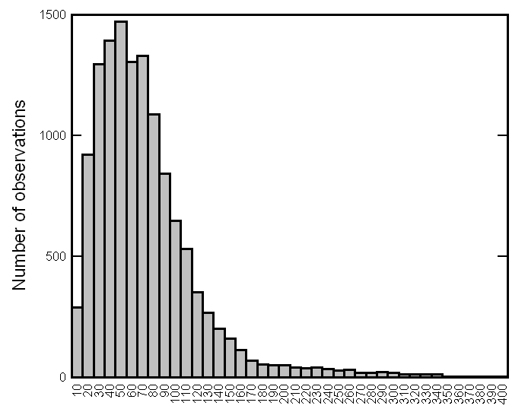
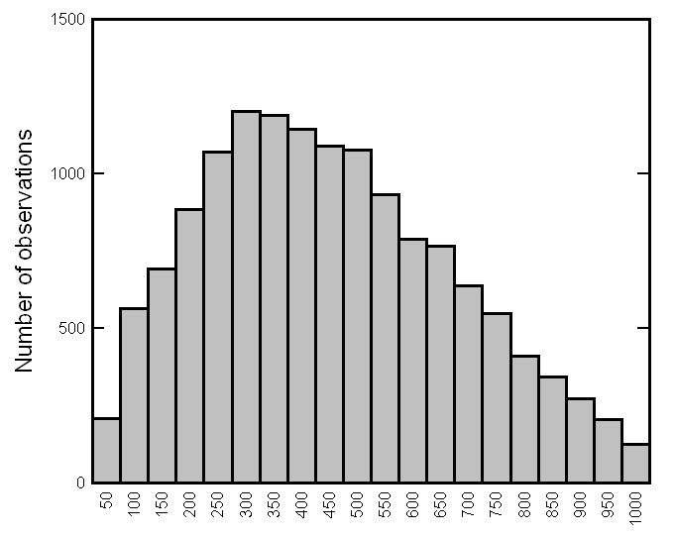
Pattern 8: Log-normal movement distances
Random
Optimal
departure
Optimal cell-
short range
Optimal cell-
long range

Slide 49
Final score for hypothesized behaviour models:
Patterns | Random | Optimal departure | Optimal destination- short distance | Optimal destination- long distance
1) Pest reduction by birds | ✓ | ✓ | ✓ | ✓
2) Infestation higher in sun coffee | ✓ | ✓ | ✓ | ✓
3) Bird densities higher in shade coffee |  | ✓ | ✓ | ✓
4) Bird effect increases with infestation rate | ✓ | ✓ | ✓ | ✓
5) Higher bird density during food irruptions |  |  | ✓ | ✓
6) Bird density varies with food availability | ✓ | ✓ | ✓ | ✓
8) Log-normal movement distance distribution | ✓ |  | ✓
9) Episodic pest consumption | ✓ | ✓ | ✓ | ✓

Slide 50
Conclusions about foraging theory for the coffee farm model
Theory must assume birds have the ability to detect and seek profitable foraging locations
Over short (not long) distances

Slide 51
General conclusions about behavior theory for IBMs to assess ecosystem services
The use of multiple observed patterns to test alternative hypotheses is a productive way to develop theory for individual behavior
Classical behavior theory often fails in individual-based population models
More realistic level of complexity
Feedbacks: Behavior affects competition affects behavior

Slide 52
Some results from this model:
Even relatively small areas of tree and shade coffee habitat could support enough birds to suppress CBB in sun coffee
Fragmentation of tree habitat was unimportant
When bug-productive habitat was lacking, converting small areas of sun coffee to shade coffee produced a net increase in uninfested coffee
Too much tree & forest habitat reduced consumption of CBB by birds – too much other good food
Railsback, S. F. and M. D. Johnson. 2014. Effects of land use on bird populations and pest control services on coffee farms. Proceedings of the National Academy of Sciences of the United States of America 111:6109-6114.

